Slide 1
COMS E6998: Microservices and Cloud Applications Lecture 7: Class Evaluation, OAuth2/FB/Twitter, AWS Security, 12 Factor Apps, Step Functions
Dr. Donald F. Ferguson
dff9@columbia.edu

Slide 2
OpenID, scopes, IANA, claims, rules
Jwt scopes
Winston/logging
Skip DynamoDB
Redis, Neo4J, memcache
https://www.npmjs.com/package/request-http-cache
Request routing based on header/data

Slide 4
Authorization

Slide 5
Division of Responsibility

Slide 6
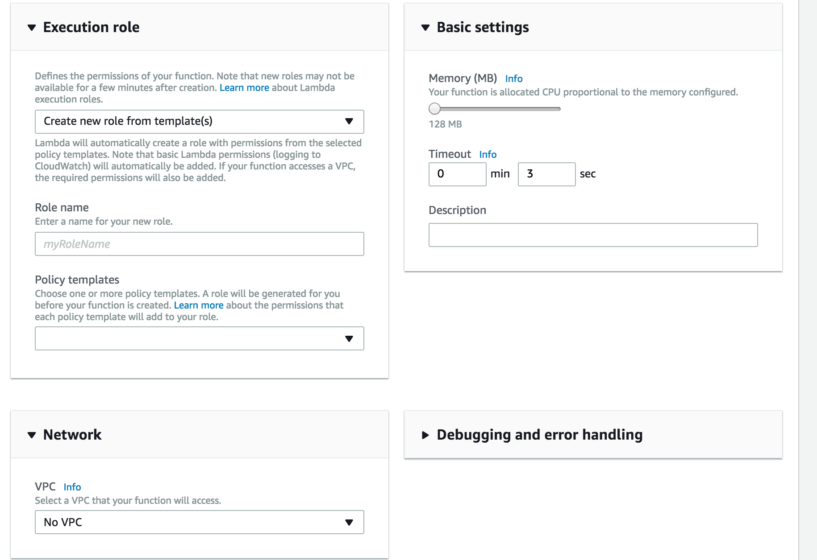
Division of Responsibility
Resources
DynamoBD tables.
S3 buckets.
SNS topics.
etc.
Have unique ARNs.
Your elements
That “do something,” e.g.
EC2 instance.
BeanStalk app.
Lambda functions.
Execute in a role (ID)
Have associated policies that specify allowed
Operations
On resources

Slide 7
Division of Responsibility

Slide 8
Division of Responsibility
The application and supporting middleware and libraries are responsible for authorization of application-level resources, e.g.
Specific database tables or tuples.
Specific DynamoDB tables or documents.
Performing specific operations on URLs.
Same basic model
Application defined “resource names,” e.g.
/customers/accounts/21
/customers/*
Authenticated users maps to named roles with associated policies, e.g.
{“Agent”, “/crm/agents/21/accounts/*”, {POST, DELETE, GET, PUT}}
{“Customer”, ”/commerce/customer/carts/*”, {POST, DELETE, GET, PUT}}
Authorization checks
Explicit calls in application code, or
Handler/interceptor middleware similar to ETag and Idempotency checks.
Security admin application that allows
Defining application resource templates and operations.
Creating and associating policies and roles.
Table for mapping IDs to roles and policies.

Slide 9
Authorization
Security Microsevice
CRUD resources ID, roles, policies
Central API for checking operation authorization from code.
Previous
Login Flow

Slide 10
Authorization
User logon to service/environment
Via email, Facebook, Twitter
Generates and returns a JWT token with identity, role and policy information.
Which flows in a customer header on also subsequent requests.
API Gateway
Calls Custom Authorizer with headers, URL, body, query params.
Custom authorizer calls authorization microservice (2nd Lambda)
Which returns decision → Customer Authorizer → API Gateway.
Other environments, e.g. Lambdas, BeanStalk
Also call authorization microservice
Passing resource, user info, operation
To determine if authorization allowed.
2nd part of project 4 will be fleshing out authorization to support 1st part of project 4, which is authentication/registration via social media.

Slide 11
Backup

Slide 12
Authorization
1st check occurs at perimeter in API GW Authorization
Based on (bearer token) JWT token
Is this role authorized to invoke this URL?
Implementation
Lambda function that …
Checks an authorization table (role, URL)
Or the rights are encoded in the token.
All down stream microservices
Receive the JWT token and perform their own authorization decisions.
Run with a set of AWS roles and permissions that determine if AWS allows access, which may include user role.

Slide 13
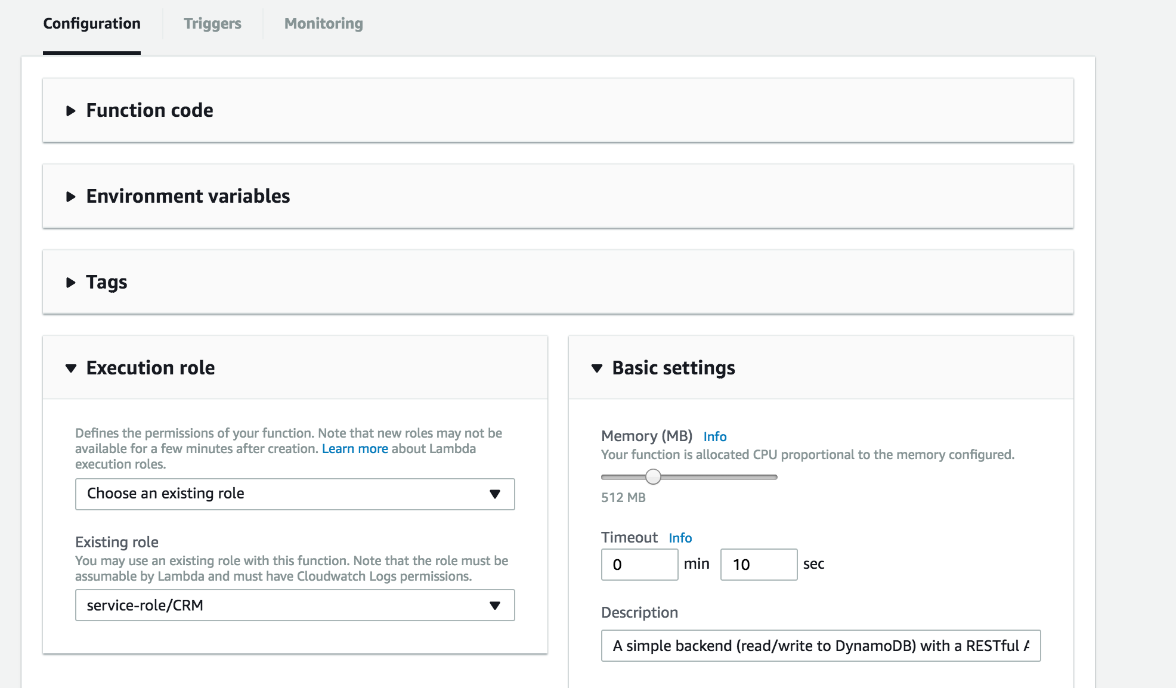
An Example – Lambda Function Role

Slide 14
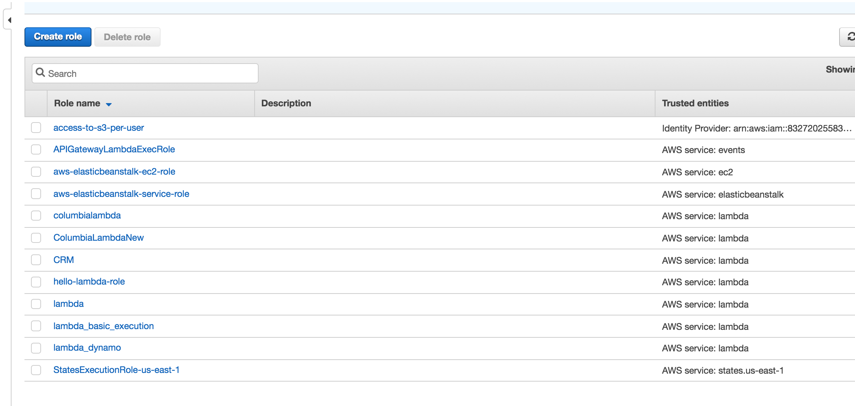
Role/Policies

Slide 15
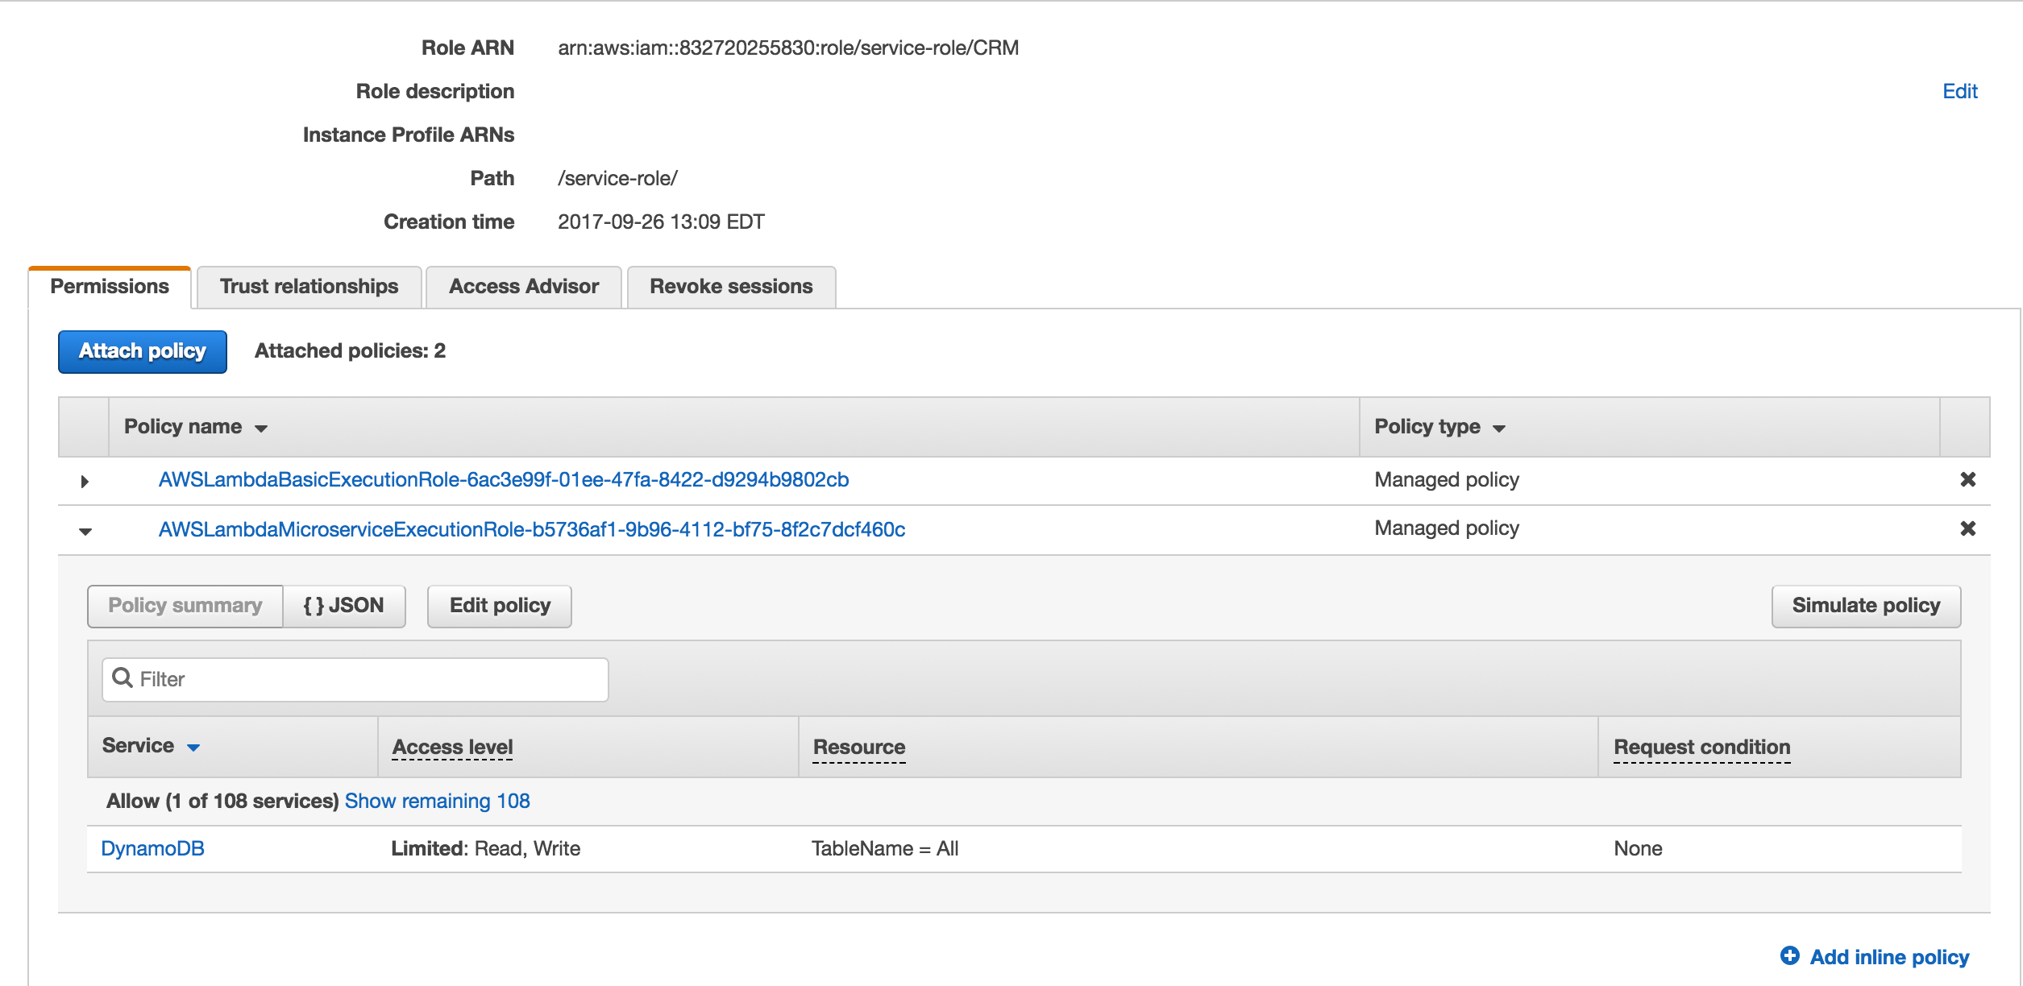
Role/Policy

